Slide 1
Microsoft SQL Server, PowerBI, Microstrategy, Access, Toad & OutlookSoft Project Portfolio
By
Bob Mead

Slide 2
SetFocus, LLC
SetFocus is a Microsoft Gold Partner that provides hands-on training for the IT professional.
Recognized as a world leader, SetFocus graduates are sought after for their expertise in Microsoft BI, .NET, SharePoint and T-SQL skill sets.

Slide 3
SetFocus BI Master’s Program

Slide 4
BI Master’s Program Projects’ Details
    Existing data from diverse data sources was consolidated into a uniform SQL Server 2008 database. ETL capabilities of SSIS were used to define imports of data, build scheduling packages, define integration flow, log data error exceptions and orphaned data and to define Database Maintenance Plans and send emails.
    Created cubes, dimensions, and KPIs using SSAS representing aggregations in different ways - hierarchically and using custom groupings. Created MDX queries according to business requirements.

Slide 5
BI Master’s Program Projects’ Details
    Developed detail and summary reports, line and pie charts, trend analysis reports and sub-reports according to business requirements using SSRS, Excel and PowerPivot.
    Implemented Business Intelligence dashboards using SharePoint producing different summary results based on user view and role membership.
    Created scorecards using Performance Point Services 2008 Dashboard Designer that featured executive summary measures for revenue, overhead costs, material purchases and labor extracting data from SQL Server 2008 OLAP data source and deployed to SharePoint sites. The dashboards also contained pages to view performance by employee, by region, and by quarter enabling end-users to make filter selections.

Slide 6
BI Master’s Program Projects’ Details
    Key areas utilized also include data modeling, SSRS report subscriptions and data driven subscriptions, SSAS analysis services processing tasks, cube processing options and roles.
    Studied and reviewed application of Kimball data warehouse methodology across various industries. Worked with data-handling scenarios, such as multiple hierarchies, data-driven KPI goals, sourced either from dimension attributes or fact tables, handling Type-2 slowly changing dimensions. Possess solid knowledge of writing, tuning and optimizing T-SQL queries.

Slide 7
T-SQL Project - Union Clause
select ((case when ee.BusinessEntityID >0 then 'Employee' end) as RecordType , (EE.LastName +', '+ EE.FirstName+', '+isnull(EE.MiddleName, ' ')) as Name, EE.AddressLine1, ISNULL(EE.AddressLine2, ' ') as AddressLine2, EE.City, EE.StateProvinceName , EE.PostalCode
from AdventureWorks2008R2.HumanResources.vEmployee as EE
Union
Select (case when VA.BusinessEntityID > 0 then 'Vendor' end) as RecordType, VA.Name, VA.AddressLine1, isnull(VA.AddressLine2, ' ') as AddressLine2, VA. City, VA.StateProvinceName, VA.PostalCode
from AdventureWorks2008R2.Purchasing.vVendorWithAddresses As VA
order by PostalCode

Slide 8
T-SQL Project - Common Table Expression
;with ShipCTE as(
Select PSM.Name, Sum(PPH.Freight) as TotFreight, PPH.ShipMethodID
from Purchasing.ShipMethod as PSM
Join Purchasing.PurchaseOrderHeader as PPH on PPH.ShipMethodID = PSM.ShipMethodID
where DATEPART(q, OrderDate) = 1 and YEAR(OrderDate)= '2007'
group by PSM.Name, PPH.ShipMethodID)
Select Vend.Name, ShipCTE.TotFreight
from Purchasing.ShipMethod as Vend
left outer join ShipCTE
on Vend.ShipMethodID = ShipCTE.ShipMethodID
order by ShipCTE.TotFreight desc

Slide 9
T-SQL Stored Procedure to Create Table
USE [2011B3DWFinal]
GO
IF EXISTS (SELECT * FROM sys.objects WHERE object_id = OBJECT_ID(N'[dbo].[DimQuestion]') AND type in (N'U'))
DROP TABLE [dbo].[DimQuestion]
GO
USE [2011B3DWFinal]
GO
SET ANSI_NULLS ON
GO
SET QUOTED_IDENTIFIER ON
GO
CREATE TABLE [dbo].[DimQuestion](
[QuestionPK] [int] NOT NULL,
[SubCategory] [smallint] NOT NULL,
[Question] [nvarchar](4000) NOT NULL,
[Description] [nvarchar](50) NULL,
PRIMARY KEY CLUSTERED
([QuestionPK] ASC)WITH (PAD_INDEX = OFF, STATISTICS_NORECOMPUTE = OFF, IGNORE_DUP_KEY = OFF, ALLOW_ROW_LOCKS = ON, ALLOW_PAGE_LOCKS = ON) ON [PRIMARY]) ON [PRIMARY]
GO

Slide 10
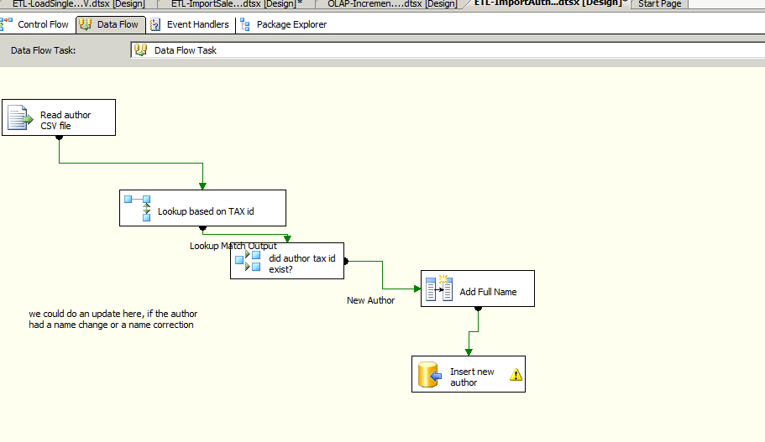
Book Sales Project SSIS ETL - .CSV File Extraction
Created ETL process to extract data from *.csv files; extraction was loaded to a data warehouse

Slide 11
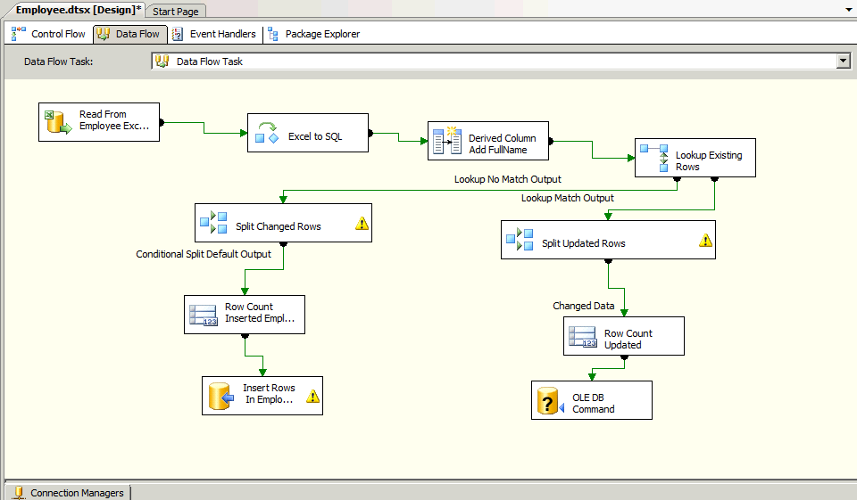
SSIS ETL - Excel Extraction
Created ETL process to extract data from Excel files; extraction was loaded to a data warehouse

Slide 12
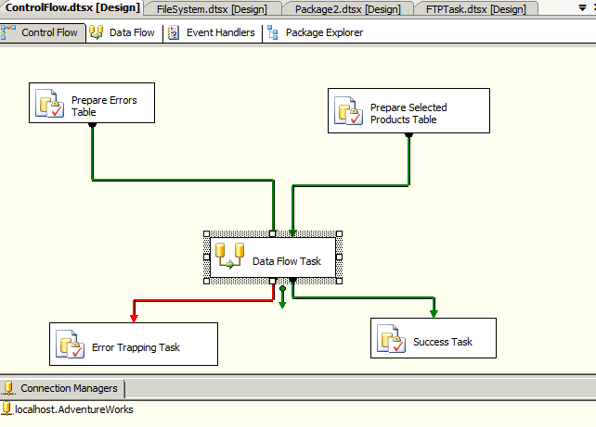
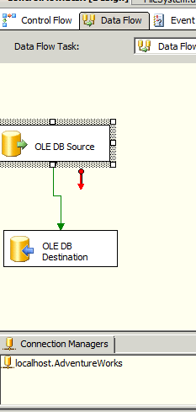
SSIS ETL - OLE DB & Control Flow Extraction
Created ETL process to extract data from an OLE DB source; extraction was loaded to a data warehouse, Control flow here logs errors when they occur.

Slide 13
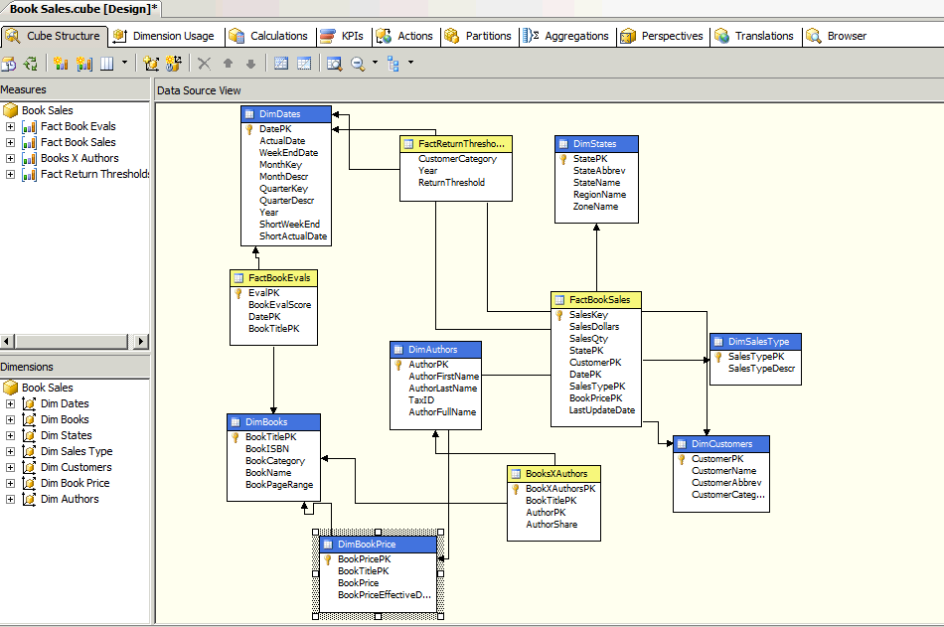
SSAS Book Sales Project -
OLAP Cube Structure

Slide 14
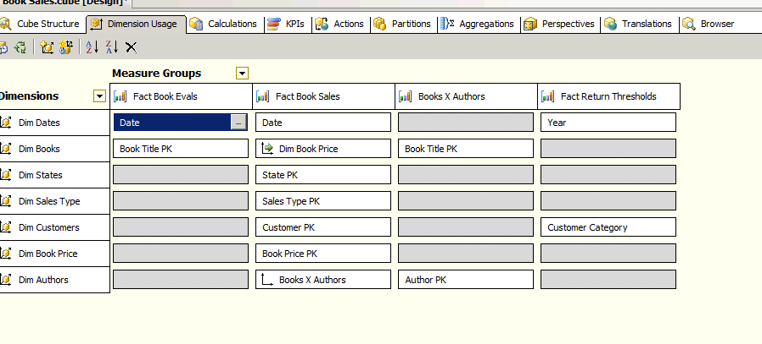
SSAS OLAP Book Sales Project - Cube Dimensions

Slide 15
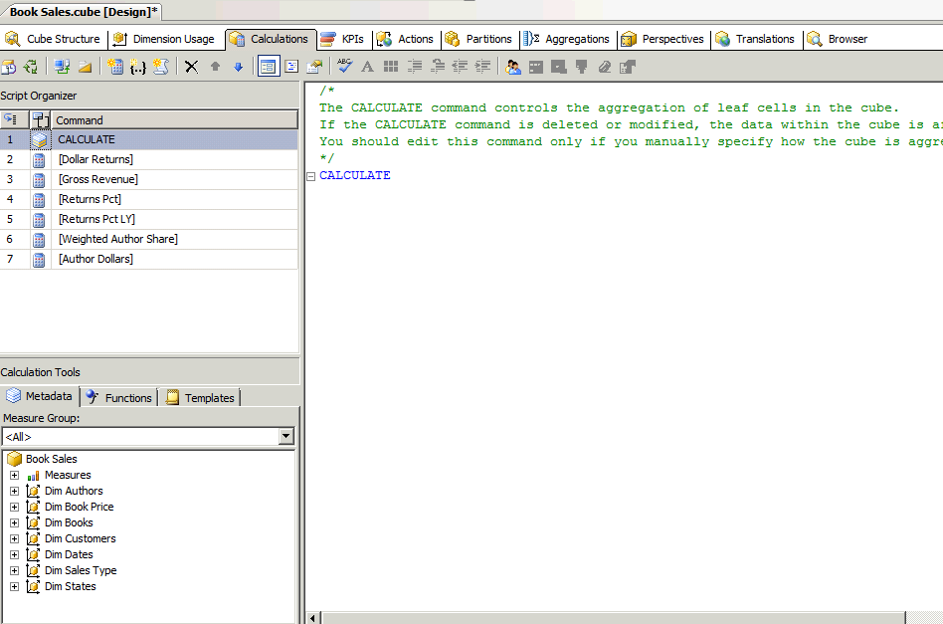
SSAS OLAP Book Sales Project - Cube Calculations

Slide 16
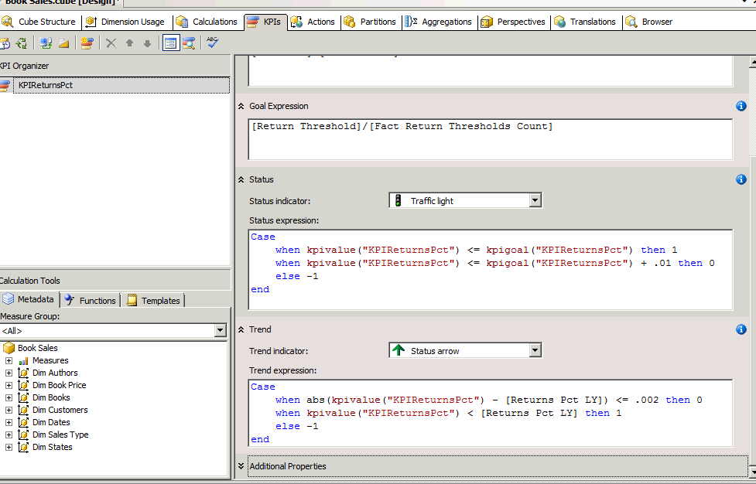
SSAS OLAP Book Sales Project -
Cube KPI

Slide 17
SharePoint 2010, Performance Point Services, SSRS &
Excel Services Project
Created reports in SSRS and Excel according to design requirements, SharePoint site collection URLs defined
SharePoint site collection files created, report delivery subscriptions defined and created
Reports deployed to SharePoint
Dashboards, reports, filters, KPIs and charts created in Performance Point Services
Final Dashboard deployed to SharePoint

Slide 18
MDX Code Sample - Sales Map & Chart Data Set
with set [OrderBySales] as
Order(filter ([Store].[Geography Hierarchy].[State Province Name].members, [Sales Amount] > 0), [Sales Amount], bdesc)
set [OrderbyReturnsPct] as
Order(filter([Store].[Geography Hierarchy].[State Province Name].members, [Sales Return Pct]>0), [Sales Return Pct], basc)
Member [SalesRank] as
Rank([Store].[Geography Hierarchy].currentmember, [OrderbySales])
Member [ReturnsPctRank] as
Rank([Store].[Geography Hierarchy].currentmember, [OrderbyReturnsPct])
Select non empty {[Measures].[Sales Return Pct], [Measures].[Sales Amount], [SalesRank], [ReturnsPctRank]} on columns,
Filter([Store].[Geography Hierarchy].[State Province Name].members, [Sales Amount] > 0 or [Sales Return Pct] > 0) on rows
from [Operation]
where (strtoset(@DateFiscalYQM), [Store].[Region Country Name].&[United States])
The above code was necessary for the rank requirements of the report.

Slide 19
SSRS Sales Map and Chart

Slide 20
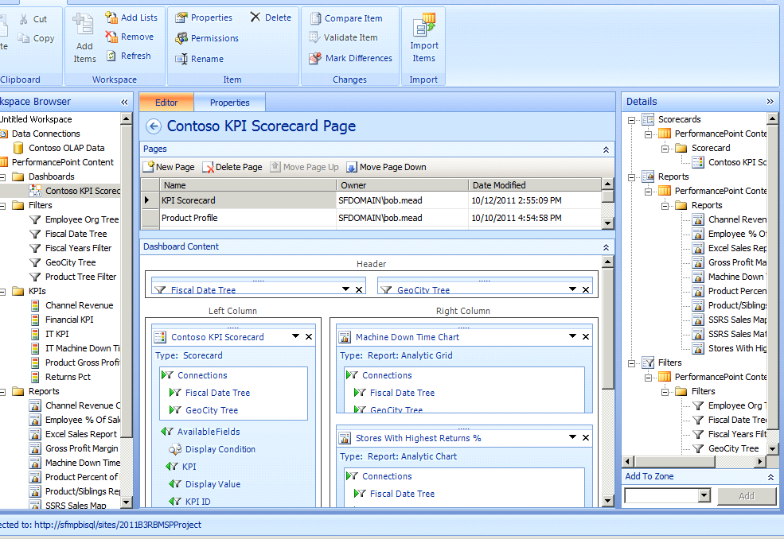
PowerPoint Services Dashboard Designer

Slide 21
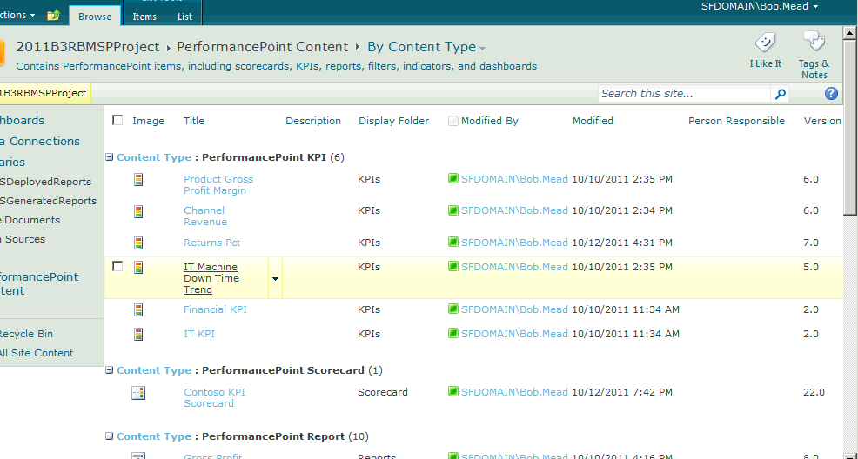
SharePoint Site Collection

Slide 22
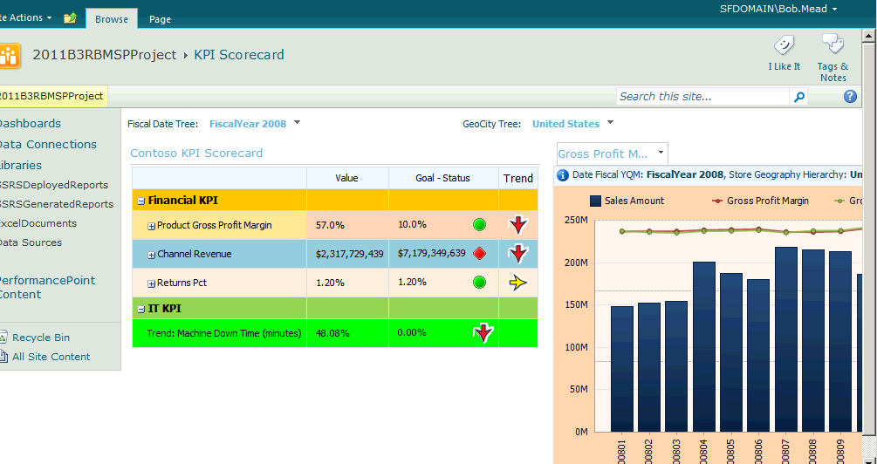
SharePoint Dashboard KPIs & Chart

Slide 23
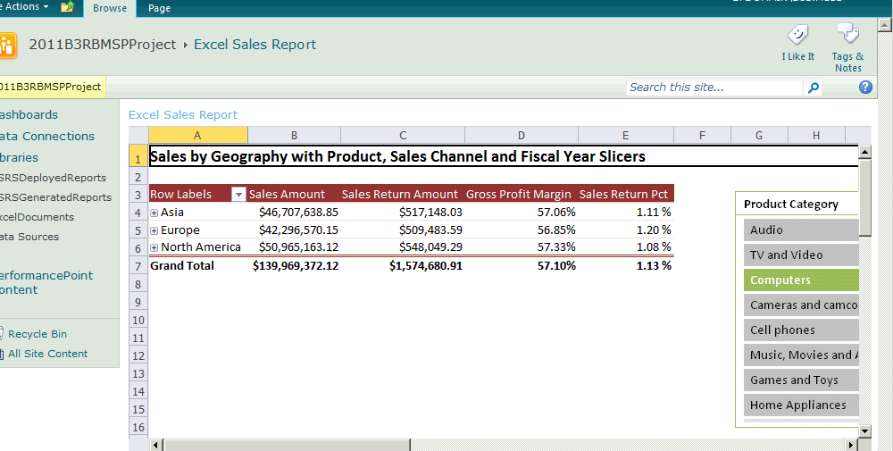
SharePoint Dashboard Excel Report with Slicers

Slide 24
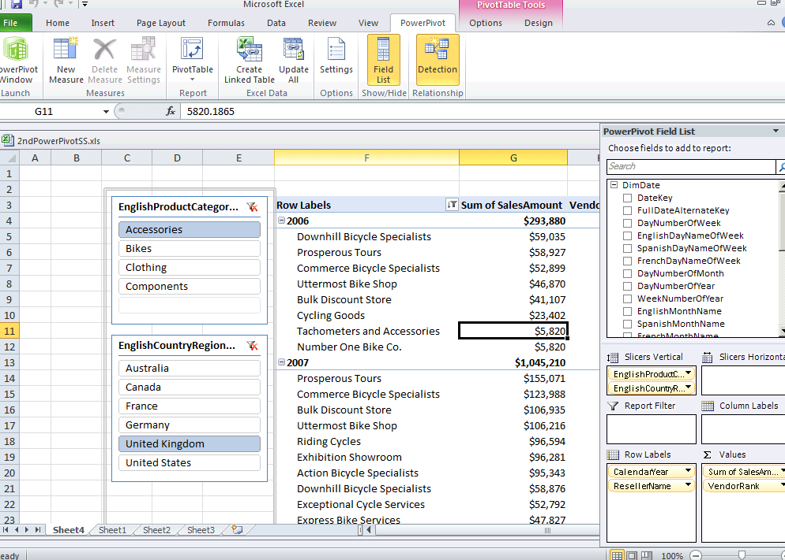
Power Pivot Report

Slide 25
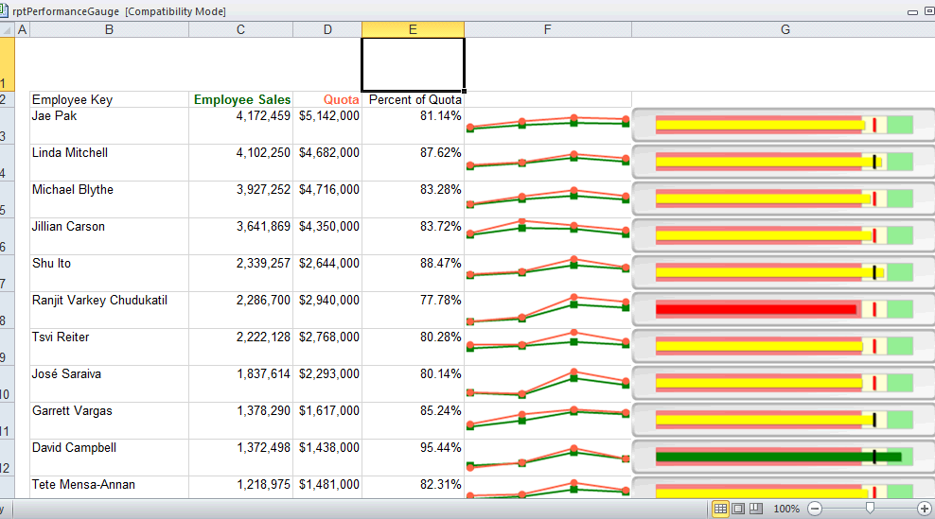
Excel Report With Sparklines Using OLAP Data Source

Slide 26
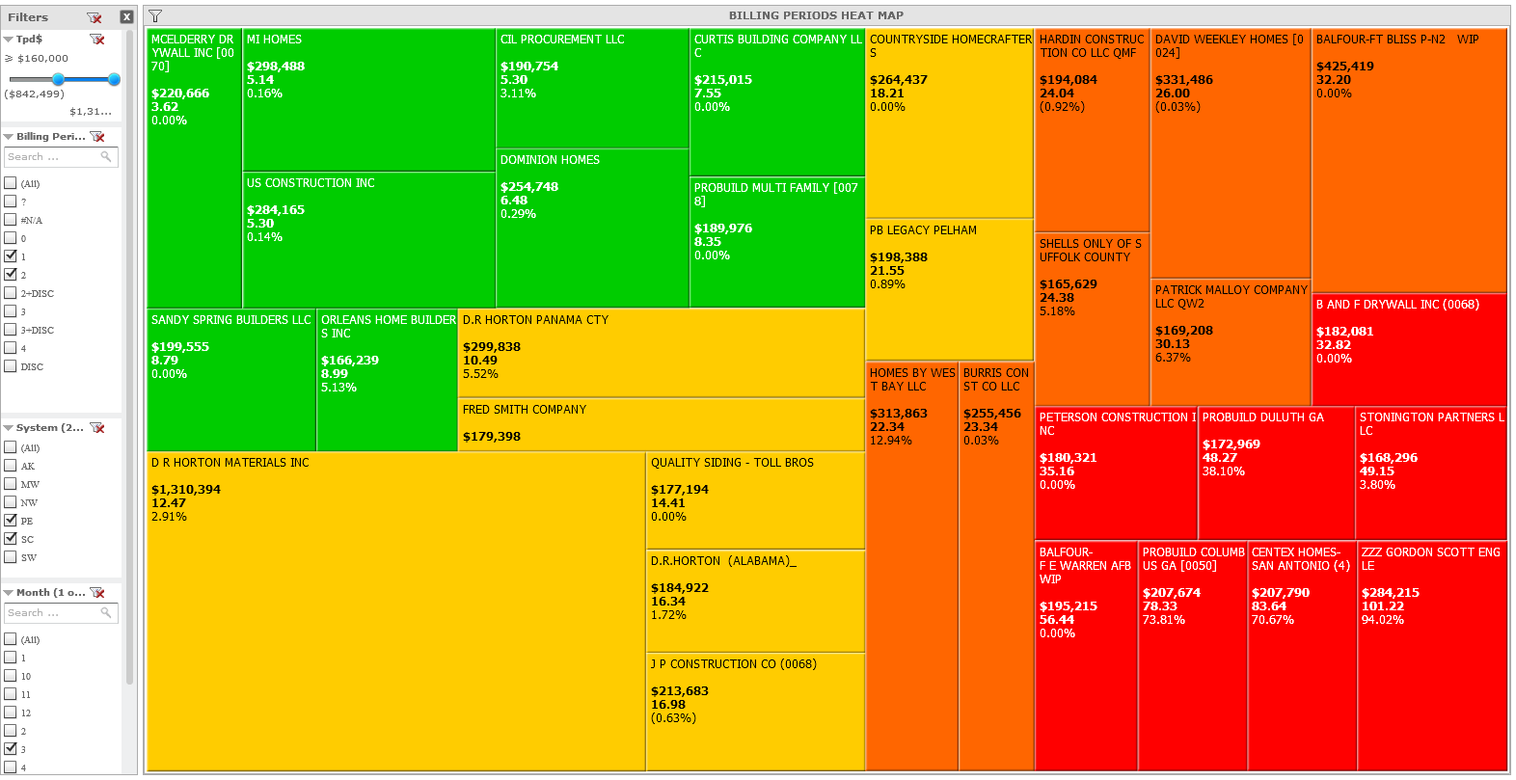
Microstrategy: Default Risk Heat Map

Slide 27
Microstrategy/Excel: Default Risk Tabular Report
Parameter | Value |  | Total | System/Region | Count | % | Weight | %TPD Range | DBT WT Range | TPD Range
TPD% | >= 10% | AvgTPD$ | $42,473 | AK | 6 | 1.6% | 1 | 10%-30% | 17.5-30 | $10K-$30K
TPD$ | >= $10K | Avg %TPD | 114.2% | MW | 69 | 17.9% | 2 | >30%-50% | >30-50 | >$30K-$50K
DBT | >= 17.5 | Avg DBT | 76.1 | NW | 30 | 7.8% | 3 | >50% | >50 | >$50K
 |  |  |  | PE | 125 | 32.5%
 |  |  |  | SC | 116 | 30.1%
 |  |  |  | SW | 39 | 10.1%
 |  |  |  | GT | 385 | 100.0%
System | Account Number | Customer Name | AvgTPD$ | %TPD | DBT | Rating: Worst To Best | %TPD WT | DBT WT | AvgTPD$ WT
SC | ATL-804131 | FORTUNE JOHNSON THE VIEWS WIP | $217,937 | 344.7% | 87.5 | 9 | 3 | 3 | 3
SC | CEN-91587 | NORTHSHORE HOMES, LLC | $196,839 | 94.2% | 99.0 | 9 | 3 | 3 | 3
MW | 512-00129660-000 | RON ZEKE BUDNIK BUILDER | $193,580 | 98.5% | 88.6 | 9 | 3 | 3 | 3
PE | 89136 | FRED SMITH COMPANY | $185,319 | 97.3% | 72.8 | 9 | 3 | 3 | 3
PE | 78720 | MA CONSTRUCTION LLC (0068) | $159,436 | 87.1% | 62.2 | 9 | 3 | 3 | 3
PE | 23340 | SCIUGA CUSTOM BUILDERS | $129,453 | 72.5% | 57.2 | 9 | 3 | 3 | 3
SC | ATL-804086 | H J RUSSELL-CLAFLIN UNV BILL | $123,252 | 100.0% | 75.0 | 9 | 3 | 3 | 3
SC | ATL-804108 | DPR CONST-CRESCENT HOWELL RET | $120,904 | 100.0% | 75.0 | 9 | 3 | 3 | 3
PE | 86250 | HART ROOFING LLC | $99,642 | 105.2% | 102.4 | 9 | 3 | 3 | 3
MW | 346-60164000-000 | TOLLBERG HOMES LLC | $89,639 | 97.9% | 88.3 | 9 | 3 | 3 | 3
PE | 71746 | ORLEANS HOME BUILDERS INC | $87,802 | 100.0% | 105.1 | 9 | 3 | 3 | 3
PE | 63137 | BERKS CONSTRUCTION CO INC | $84,845 | 100.0% | 103.7 | 9 | 3 | 3 | 3
SC | CEN-92735 | CENTEX HOMES-SAN ANTONIO | $83,851 | 86.3% | 72.6 | 9 | 3 | 3 | 3
PE | 61187 | JOSEPH MOHR CONST INC | $79,073 | 79.7% | 60.1 | 9 | 3 | 3 | 3
SC | ATL-804124 | HJ RUSSELL-SOUTHSIDE RET | $67,333 | 100.0% | 75.0 | 9 | 3 | 3 | 3
MW | 920-00008400-000 | SP INVESTMENTS | $63,668 | 95.9% | 100.7 | 9 | 3 | 3 | 3
PE | 81062 | DIORIO CONSTRUCTION LLC | $61,144 | 75.9% | 58.9 | 9 | 3 | 3 | 3
MW | 213-00000208-000 | STU CHAMBERS | $60,332 | 90.2% | 94.7 | 9 | 3 | 3 | 3
SC | OKC-39766 | GAGNON ROOFING GENERAL CONTRAC | $59,407 | 90.7% | 95.3 | 9 | 3 | 3 | 3
SC | CEN-955476 | JRS VENTURES INC DBA NEWPORT C | $58,844 | 94.4% | 98.5 | 9 | 3 | 3 | 3
SC | ATL-804138 | BALFOUR - GATEWAY WEST WIP | $56,217 | 100.0% | 105.0 | 9 | 3 | 3 | 3
NW | 500-562200 | MONARCH CUSTOM HOMES INC | $54,993 | 100.0% | 102.2 | 9 | 3 | 3 | 3
SC | OKC-38991 | C & C BUILDERS, INC | $53,901 | 93.3% | 90.9 | 9 | 3 | 3 | 3
MW | 315-00501000-000 | TAMI KNAPP | $52,505 | 98.5% | 102.1 | 9 | 3 | 3 | 3
SW | 132523 | COBLE HOMES | $51,700 | 96.9% | 71.7 | 9 | 3 | 3 | 3
NW | 31-3123841 | ABBOTT RHOTON DBA CAPSTONE HOMES | $51,279 | 98.1% | 52.7 | 9 | 3 | 3 | 3
SC | DEN-20608 | SAKOTA BUILDERS INC-TOLL BROTH | $330,579 | 69.8% | 31.3 | 8 | 3 | 2 | 3
SC | ATL-606568 | CSD INSTALL ACCOUNT | $156,719 | 71.5% | 33.0 | 8 | 3 | 2 | 3
PE | 14638 | VELOCITY CONST OF VA INC [0033] | $149,523 | 87.4% | 32.8 | 8 | 3 | 2 | 3
PE | 44493 | B AND F DRYWALL INC (0068) | $148,864 | 62.9% | 35.5 | 8 | 3 | 2 | 3

Slide 28
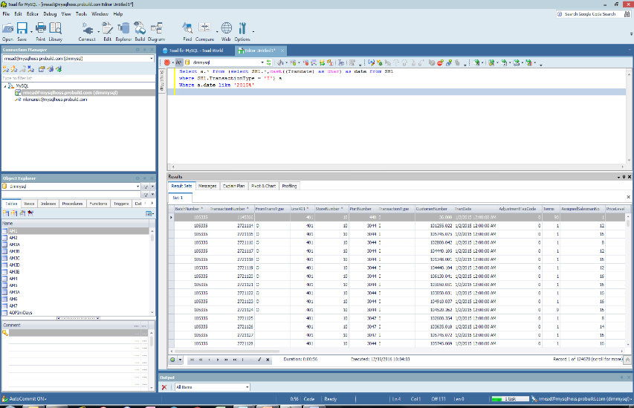
Toad Extracts & SQL

Slide 29
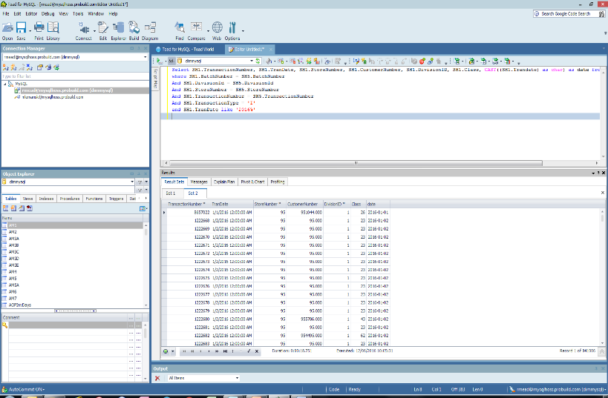
More Toad Extracts & SQL

Slide 30
OutlookSoft/Excel: Gross AR/Net AR Spreadsheet
App | Finance | FPANDA |  |  | ACTUALINPUT | ACTUALINPUT
BUSTYPE | AllBusTypes |  |  |  | 2015.JAN | 2015.FEB
DATASRC | PFCons |  |  |  | PERIODIC | PERIODIC
INTCO | All_InterCo
PRODUCT | ALL_PROD
RPTCURRENCY | LC
GEOGRAPHY | geo_AllStatistical
PB_FUNCTION | fnct_all
LOB | LOB_All
ENTITY | PBHwoLNCo_Mkts
MEASURES | in columns
ACCOUNT | in rows
CATEGORY | ACTUALINPUT
TIME | 2015.DEC | 31-Dec-15
ROUND | 1
 |  |  | ProBuild - 2015
 |  |  | ($ in millions)
 |  |  |  | Days | 31 | 28
 |  |  | Actuals |  | Jan | Feb
 |  | Net_sales |  | Sales | 304,769,922 | 271,699,331
 |  | pmt_charge |  | Charge Sales | 277,576,214 | 246,855,529
 |  |  |  | % of Total Sales | 91% | 91%
 |  | cogs |  | COGS | 226,505,572 | 201,780,269
 |  |  |  | GM% | 25.7% | 25.7%
 |  | acct_recvbl_net |  | A/R | 395,366,800 | 378,035,379
 |  | acct_recvbl |  | Gross A/R | 409,162,298 | 392,585,351
 |  | FIFO |  | Inv | 410,298,970 | 430,159,385
 |  | FIFO_materials |  | Inv Materials | 419,858,659 | 440,501,994
 | Checks_out | AP |  | A/P | (308,569,573) | (303,780,172)
 |  |  |  | Metrics
 |  |  |  | DSO | 45.7 | 44.5
 |  |  |  | Turns | 6.4 | 6.0
 |  |  |  | Inv Days | 57.0 | 60.8
 |  |  |  | Inv Effectiveness | 1.64 | 1.54
 |  |  |  | DPO | 42.2 | 42.2

Slide 31
OutlookSoft/Excel: Gross AR GL Code Detail Spreadsheet
App | Finance | FPANDA |  | Category | ACTUALINPUT | ACTUALINPUT
BUSTYPE | AllBusTypes |  |  | Measures - Time | 2015.JAN | 2015.FEB
DATASRC | PFCons |  |  | Measures - Time | PERIODIC | PERIODIC
INTCO | All_InterCo
PRODUCT | ALL_PROD
RPTCURRENCY | LC
GEOGRAPHY | geo_AllStatistical
PB_FUNCTION | fnct_All
LOB | LOB_All | Lumber, Millwork Etc
ENTITY | PBHwoLNCo_Mkts
MEASURES | in columns
ACCOUNT | in rows
CATEGORY | ACTUALINPUT
TIME | 2015.DEC | December 31, 2015
ROUND | 1
 |  |  | ProBuild - 2015
 |  |  | ($ in millions)
 |  |  | Actuals |  | Jan | Feb
 |  | XXPB ACCOUNT
Account |  | 11000 | Receivables | Receivables | 280,808,282 | 264,484,029
Account |  | 11001 | Dim Receivables | Dim Receivables | 105,240,478 | 105,273,190
Account |  | 11010 | Trade Receivables | Trade Receivables | 9,837,820 | 10,846,928
Account |  | 11020 | WORKING CAPITAL AR Allocation | WORKING CAPITAL AR Allocation | 0 | 0
Account |  | 11200 | On Account Receipts | On Account Receipts | (41,237) | (43,663)
Account |  | 11300 | Unapplied Receipts | Unapplied Receipts | (3,452,016) | (4,558,955)
Account |  | 11400 | UNIDENTIFIED RECEIPT | UNIDENTIFIED RECEIPT | (29,422) | (29,422)
Account |  | 11450 | Credit Card Receipt Confirmation | Credit Card Receipt Confirmation | 0 | 0
Account |  | 1161 | Reinstatement of Receivables Written Off | Reinstatement of Receivables Written Off | 0 | 0
Account |  | 1190 | AR-Suspense | AR-Suspense | 0 | 0
Account |  | 11500 | PAYMENT NETTING | PAYMENT NETTING | 0 | 0
Account |  | 11600 | NSF Checks | NSF Checks | (17,229) | 11,272
Account |  | 11100 | Unbilled Receivables | Unbilled Receivables | 16,815,623 | 16,601,972
 |  |  |  |  | $ 409,162,299 | $ 392,585,351

Slide 32
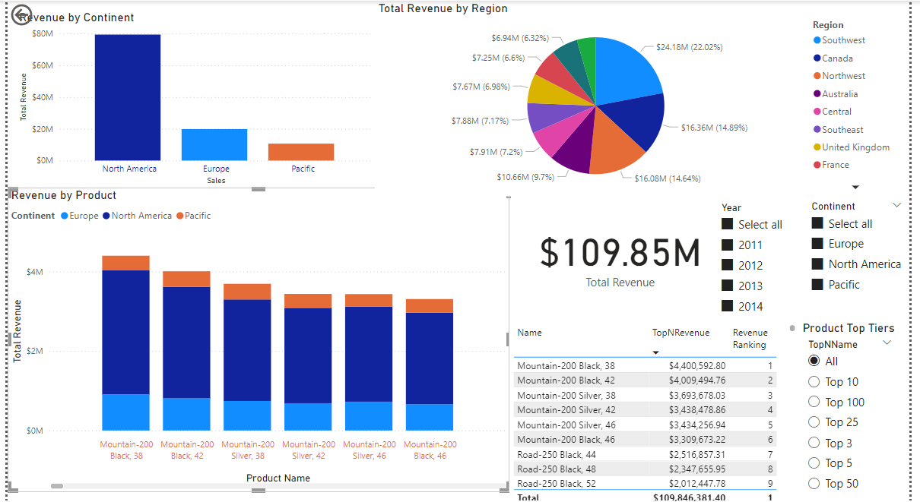
Power BI Dashboard

Slide 33
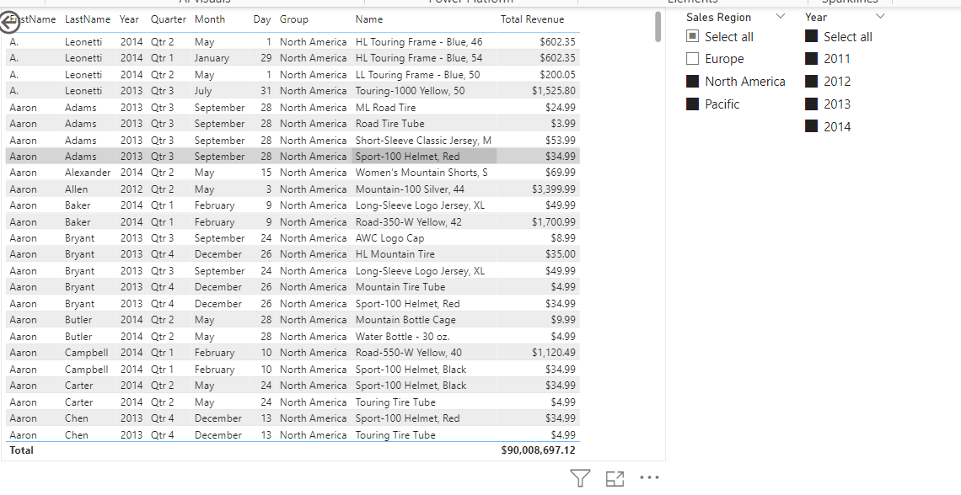
Power BI Tabular Report Linked to Previous Visuals

